Slide 1
Supervised Learning
Linear Regression
with one variable
Some slides taken from Andrew Ng’s Machine Learning course https://www.coursera.org/learn/machine-learning

Slide 2



Predicting car prices
How much is my car worth?

Slide 3
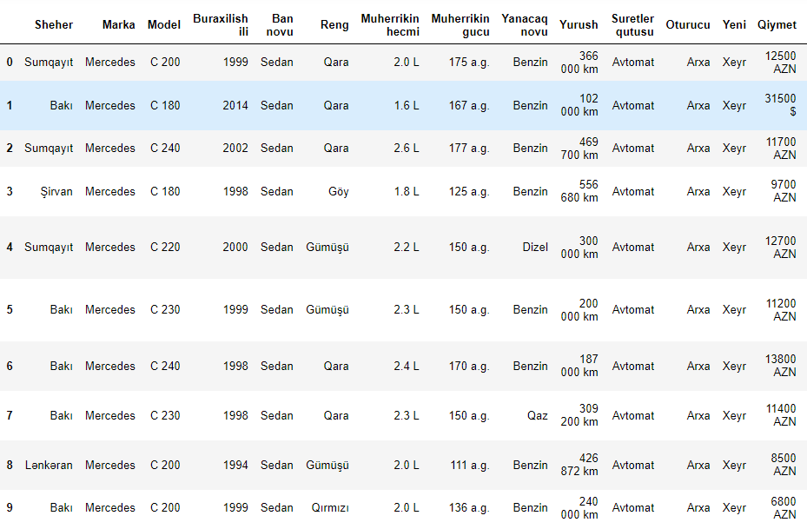


Data from turbo.az for C class-Mercedes
Notation:
n = Number of training examples
x’s = “input” variable / features
y’s = “output” variable /
“target” variable /
label
$\left\{{(x}^{(i)},y^{(i)})\text{: }i=1,…n\right\}$ - training set
$${(x}^{(i)},y^{(i)})\text{ − }\text{training} \text{example}$$

Slide 4
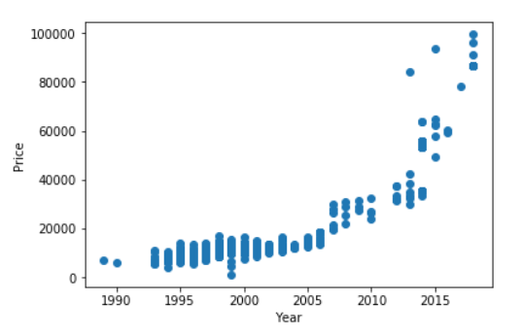
Data from turbo.az for C class-Mercedes
Supervised Learning
Given the “right answer”
for each example in the data.
Regression Problem
Predict real-valued output

Slide 5
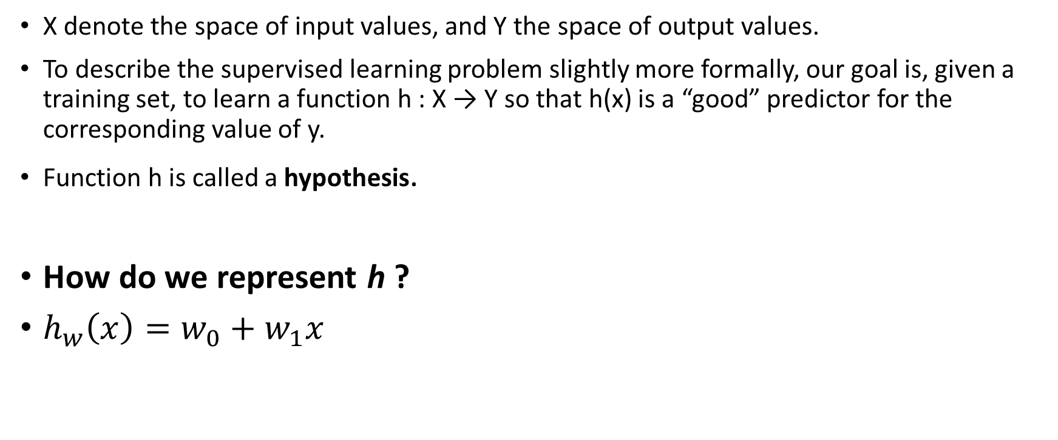
Linear Regression
X denote the space of input values, and Y the space of output values.
To describe the supervised learning problem slightly more formally, our goal is, given a training set, to learn a function h : X → Y so that h(x) is a “good” predictor for the corresponding value of y.
Function h is called a hypothesis.
How do we represent h ?
$h_{w}\left(x\right)=w_{0}+w_{1}x$
Training Set
Learning Algorithm
Linear regression with one variable.
Univariate linear regression.
X (year)
Predicted Y (price)
h

Slide 6

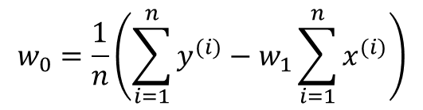
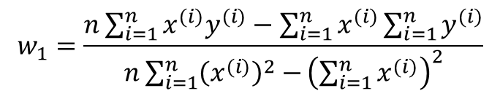

Which line?
$$h_{w}\left(x\right)=w_{0}+w_{1}x$$
(for fixed $w_{0}, w_{1}$ this is a function of x)
Analytical (algebraic) solution from Statistics
$$w_{1}=\frac{n\sum_{i=1}^{n}{x^{(i)}y^{(i)}}−\sum_{i=1}^{n}{x^{(i)}}\sum_{i=1}^{n}{y^{(i)}}}{n\sum_{i=1}^{n}{{\left(x^{(i)}\right)}^{2}−}{\left(\sum_{i=1}^{n}{x^{(i)}}\right)}^{2}}$$
$$w_{0}=\frac{1}{n}\left(\sum_{i=1}^{n}{y^{(i)}}−w_{1}\sum_{i=1}^{n}{x^{(i)}}\right)$$

Slide 7
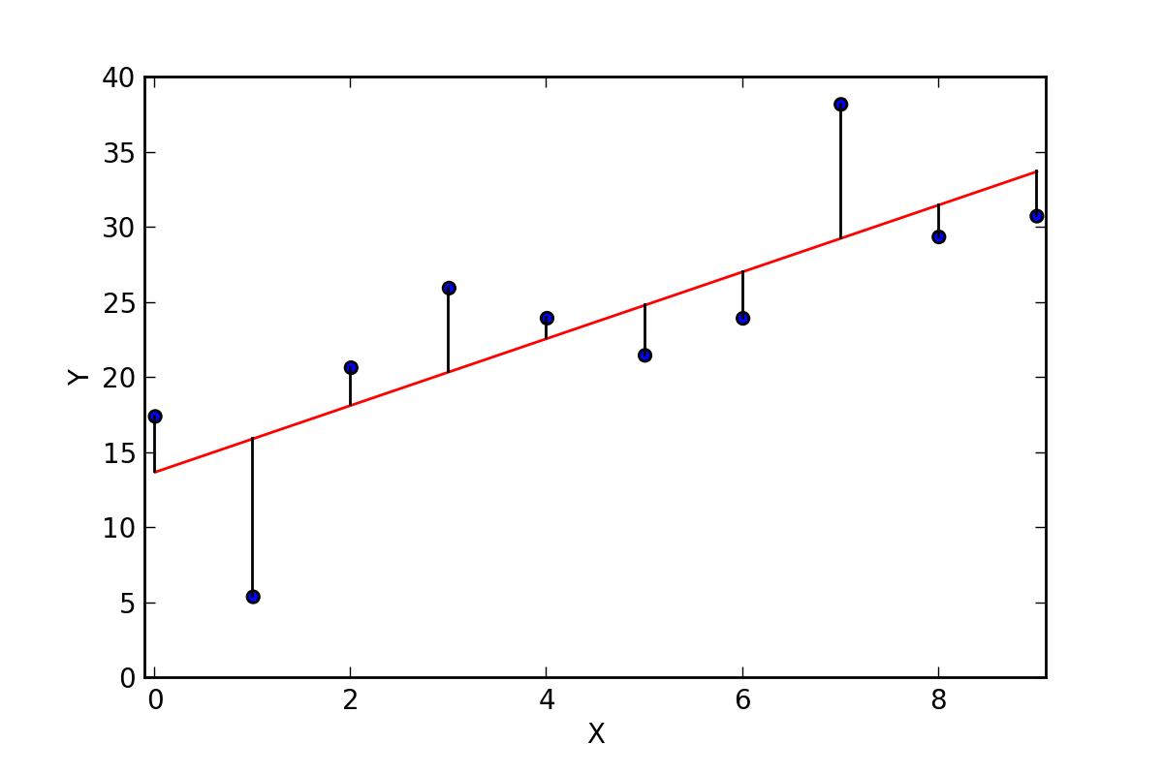






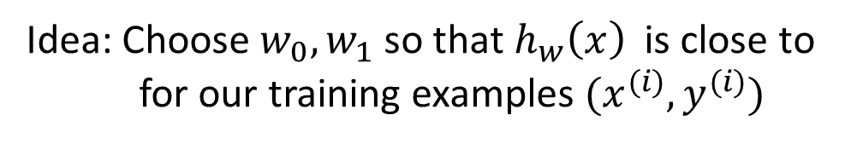
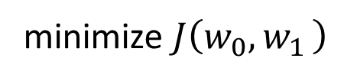
Cost Function
$\left\{{(x}^{(i)},y^{(i)})\text{: }i=1,…n\right\}$ - training set
$${{\hat{y}}^{\left(i\right)}=h}_{w}\left(x\right)=w_{0}+w_{1}x$$
${\hat{y}}^{\left(i\right)}$ predicted value
Idea: Choose $w_{0},w_{1}$so that $h_{w}\left(x\right)$ is close to for our training examples ${(x}^{(i)},y^{(i)})$
$y^{\left(i\right)}$ real value
$$J\left(w_{0}{,w}_{1}\right)=\frac{1}{2n}\sum_{i=1}^{n}{{\left( {\hat{y}}^{\left(i\right)}−y^{\left(i\right)}\right)}^{2}}= \frac{1}{2n}\sum_{i=1}^{n}{{\left(h_{w}\left(x^{(i)}\right)−y^{(i)}\right)}^{2}}$$
Cost Function:
Goal:
minimize $J\left(w_{0}{,w}_{1}\right)$
$$w_{0},w_{1}$$

Slide 8

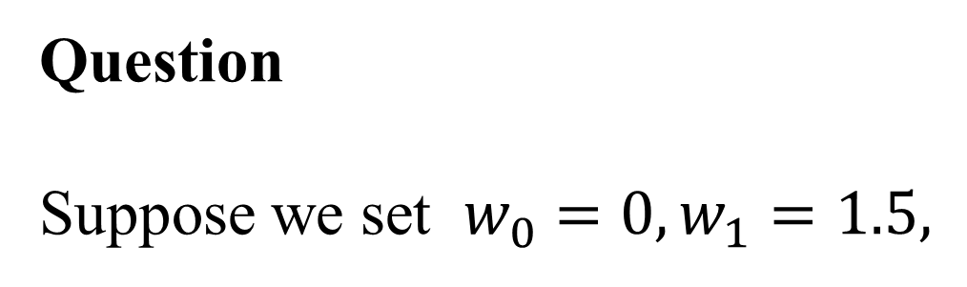
Question
Suppose we set $w_{0}=0,w_{1}=1.5,$
What is $h_{w}\left(2\right)$ for the linear hypothesis ?

Slide 9

Answer:

Slide 10



Question
Assume that we are using the training set given below. Recall our definition of the cost function was
$$J\left(w_{0}{,w}_{1}\right)= \frac{1}{2n}\sum_{i=1}^{n}{{\left(h_{w}\left(x^{(i)}\right)−y^{(i)}\right)}^{2}}$$
x | y
3 | 4
2 | 1
4 | 3
0 | 1
$$h_{w}\left(x\right)=w_{0}+w_{1}x$$
What is J(0,1)?

Slide 11

Answer: J(0,1)=0.5

Slide 12





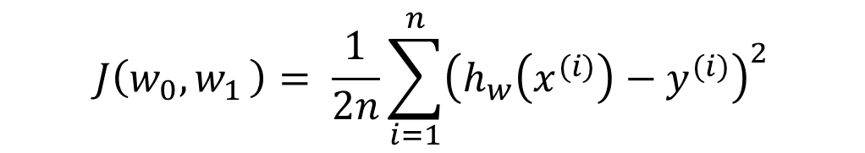
Linear Regression
Idea: Choose $w_{0},w_{1}$so that $h_{w}\left(x\right)$ is close to for our training examples ${(x}^{(i)},y^{(i)})$
Hypothesis:
$$h_{w}\left(x\right)=w_{0}+w_{1}x$$
Parameters:
$$w_{0},w_{1}$$
$$J\left(w_{0}{,w}_{1}\right)= \frac{1}{2n}\sum_{i=1}^{n}{{\left(h_{w}\left(x^{(i)}\right)−y^{(i)}\right)}^{2}}$$
Cost Function:
Goal:
min $J\left(w_{0}{,w}_{1}\right)$
$$w_{0},w_{1}$$

Slide 13
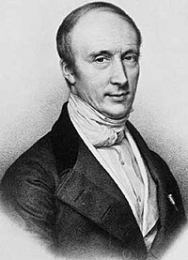
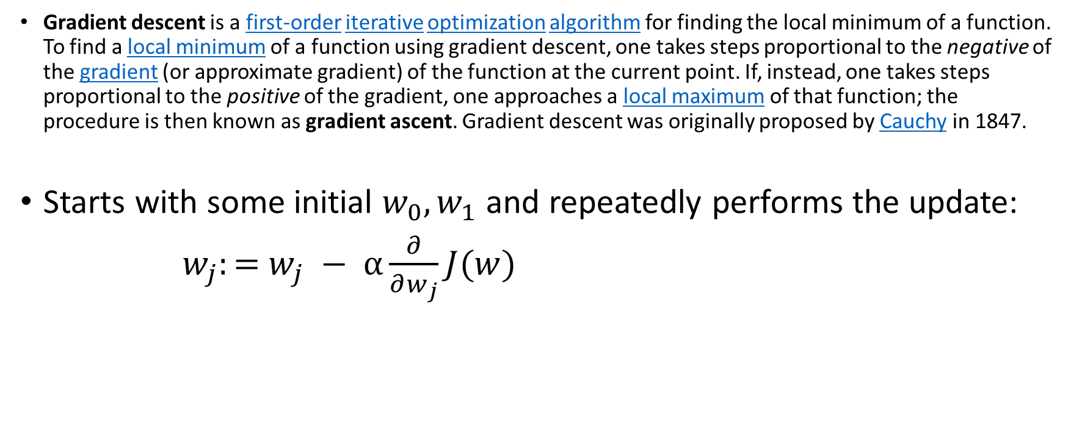
Gradient Descent algorithm
Gradient descent is a first-order iterative optimization algorithm for finding the local minimum of a function. To find a local minimum of a function using gradient descent, one takes steps proportional to the negative of the gradient (or approximate gradient) of the function at the current point. If, instead, one takes steps proportional to the positive of the gradient, one approaches a local maximum of that function; the procedure is then known as gradient ascent. Gradient descent was originally proposed by Cauchy in 1847.
Starts with some initial $w_{0},w_{1}$ and repeatedly performs the update:
$w_{j}:=$ $w_{j} − α\frac{∂}{∂w_{j}}J(w)$
α is called the learning rate.
Limitation: required gradient descent is relatively slow close to the minimum:
https://en.wikipedia.org/wiki/Gradient_descent

Slide 14



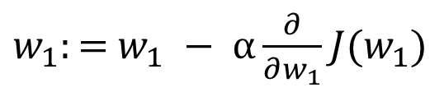





Gradient descent intuition
$w_{1}:=$ $w_{1} − α\frac{∂}{∂w_{1}}J(w_{1})$
For simplicity J(w) is one dimensional function, then
$$\frac{∂}{∂w_{1}}J\left(w_{1}\right)≥0$$
$\frac{∂}{∂w_{1}}J\left(w_{1}\right)≤$0
$w_{1}:=$ $w_{1} − α(positive number)$
$w_{1}:=$ $w_{1} − α(negative number)$
$$J\left(w_{1}\right)$$
$$J\left(w_{1}\right)$$
Negative slope
$$←w_{1}$$
$$w_{1}→$$

Slide 15

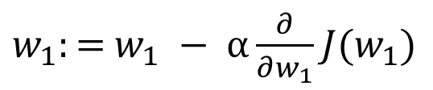


How to choose α?
$w_{1}:=$ $w_{1} − α\frac{∂}{∂w_{1}}J(w_{1})$
If α is too small, gradient descent can be slow
If α is too large, gradient descent can overshoot the minimum. It may fail to converge or even diverge
$$J(w_{1})$$
$$J(w_{1})$$
$$w_{1}$$
$$w_{1}$$
Gradient descent can converge to a local minimum, even with the learning rate α fixed. As we approach a local minimum, gradient descent will automatically take smaller steps.

Slide 16
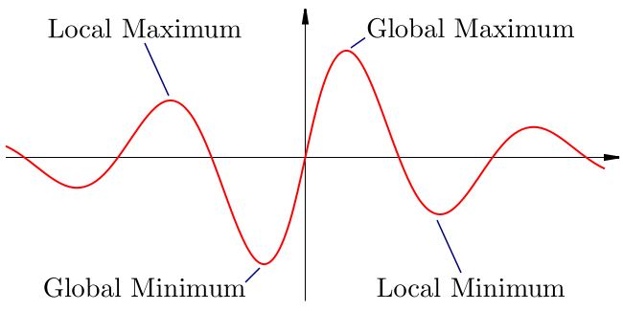

Slide 17
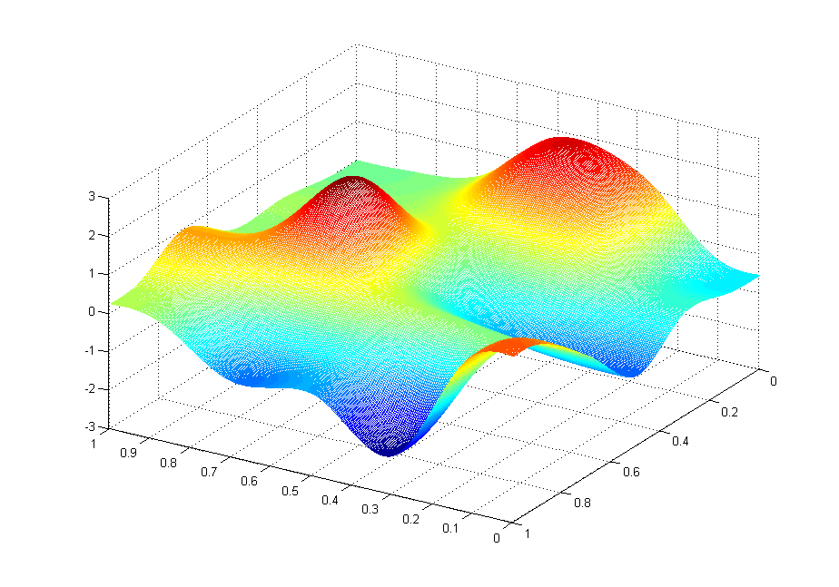



Gradient descent is a first-order iterative optimization algorithm for finding the local minimum of a function.
$$J\left(w_{0}{,w}_{1}\right)$$
$$w_{1}$$
$$w_{0}$$

Slide 18

$$J\left(w_{0}{,w}_{1}\right)$$
$$w_{1}$$
$$w_{0}$$

Slide 19


Slide 20
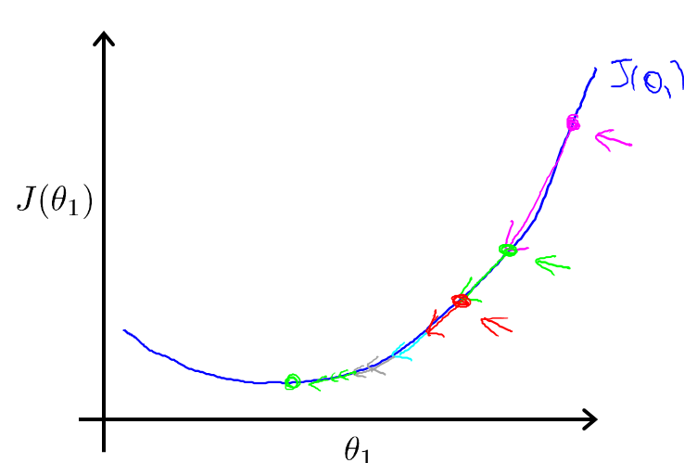


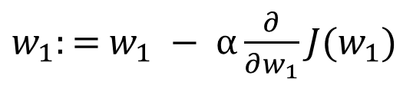
Gradient descent can converge to a local minimum, even with the learning rate α fixed.
$w_{1}:=$ $w_{1} − α\frac{∂}{∂w_{1}}J(w_{1})$
As we approach a local minimum, gradient descent will automatically take smaller steps. So, no need to decrease α over time.

Slide 21









Gradient descent algorithm
Repeat until convergence
$w_{j}:=$ $w_{j} − α\frac{∂}{∂w_{j}}J(w)$
Note! This update is simultaneously performed for all values of j = 0, . . . , d.
Correct: Simultaneous update
Incorrect:
temp0$:=$ $w_{0} − α\frac{∂}{∂w_{0}}J(w_{0},w_{1})$
temp0$:=$ $w_{0} − α\frac{∂}{∂w_{0}}J(w_{0},w_{1})$
temp1$:=$ $w_{1} − α\frac{∂}{∂w_{1}}J(w_{0},w_{1})$
$w_{0}≔$temp0
temp1$:=$ $w_{1} − α\frac{∂}{∂w_{1}}J(w_{0},w_{1})$
$w_{0}≔$temp0
$w_{1}≔$temp1
$w_{1}≔$temp1

Slide 22
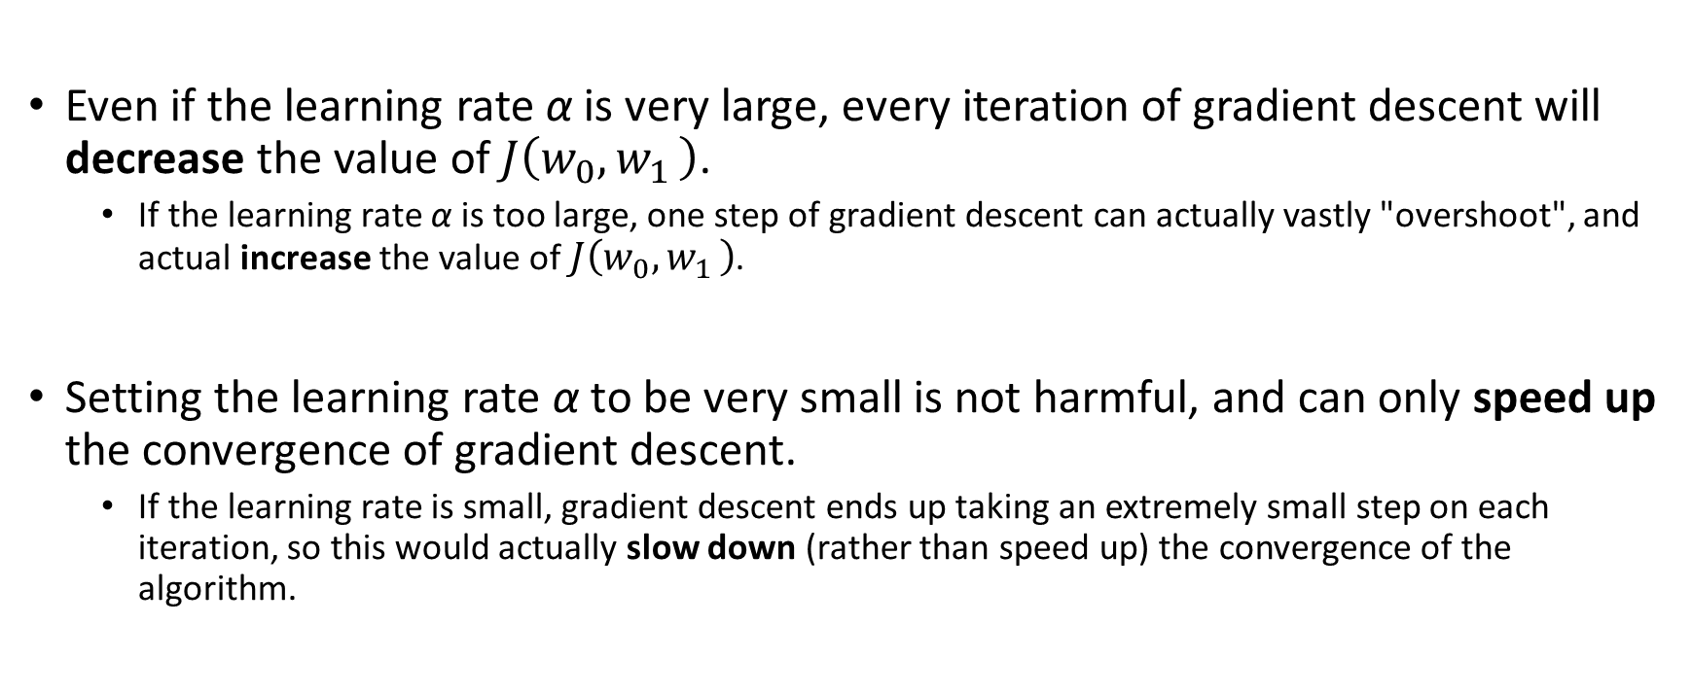
Question: Convergence of gradient method (are they true?)
Even if the learning rate α is very large, every iteration of gradient descent will decrease the value of $J\left(w_{0}{,w}_{1}\right)$.
If the learning rate α is too large, one step of gradient descent can actually vastly "overshoot", and actual increase the value of $J\left(w_{0}{,w}_{1}\right)$.
Setting the learning rate α to be very small is not harmful, and can only speed up the convergence of gradient descent.
If the learning rate is small, gradient descent ends up taking an extremely small step on each iteration, so this would actually slow down (rather than speed up) the convergence of the algorithm.

Slide 23
Questions: Convergence of gradient method
If w0 and w1 are initialized at a local minimum, the one iteration will not change their values.
At a local minimum, the derivative (gradient) is zero, so gradient descent will not change the parameters.
If w0 and w1 are initialized at the global minimum, the one iteration will not change their values.
At the global minimum, the derivative (gradient) is zero, so gradient descent will not change the parameters.
If w0 and w1 are initialized so that w0 = w1 , then by symmetry (because we do simultaneous updates to the two parameters), after one iteration of gradient descent, we will still have w0 = w1 .
The updates to w0 and w1 are different (even though we're doing simultaneous updates), so there's no particular reason to expect them to be the same after one iteration of gradient descent.

Slide 24

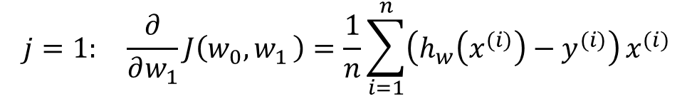
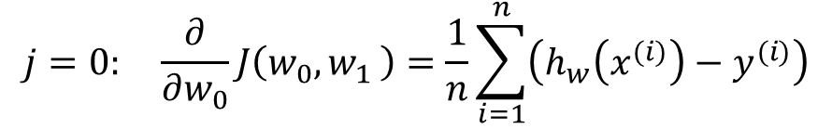
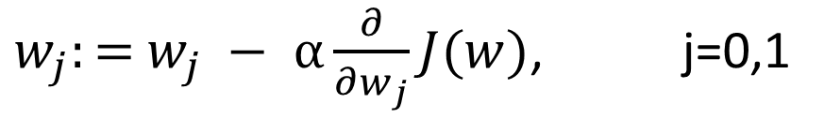
Gradient descent for linear regression
$w_{j}:=$ $w_{j} − α\frac{∂}{∂w_{j}}J(w)$, j=0,1
$$h_{w}\left(x\right)=w_{0}+w_{1}x$$
$$J\left(w_{0}{,w}_{1}\right)= \frac{1}{2n}\sum_{i=1}^{n}{{\left(h_{w}\left(x^{(i)}\right)−y^{(i)}\right)}^{2}}=\frac{1}{2n}\sum_{i=1}^{n}{{\left(w_{0}+w_{1}x^{(i)}−y^{(i)}\right)}^{2}}$$
$$j=0: \frac{∂}{∂w_{0}}J\left(w_{0}{,w}_{1}\right)=\frac{1}{n}\sum_{i=1}^{n}{\left(h_{w}\left(x^{(i)}\right)−y^{(i)}\right)}$$
$$j=1: \frac{∂}{∂w_{1}}J\left(w_{0}{,w}_{1}\right)=\frac{1}{n}\sum_{i=1}^{n}{\left(h_{w}\left(x^{(i)}\right)−y^{(i)}\right)}x^{(i)}$$

Slide 25
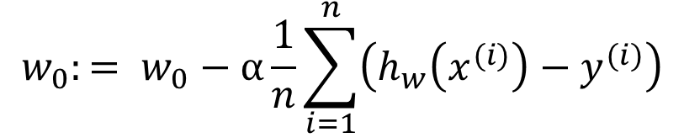
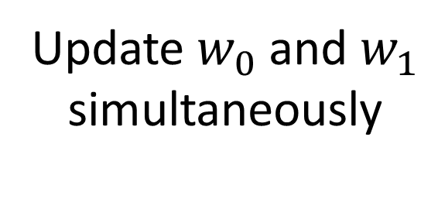
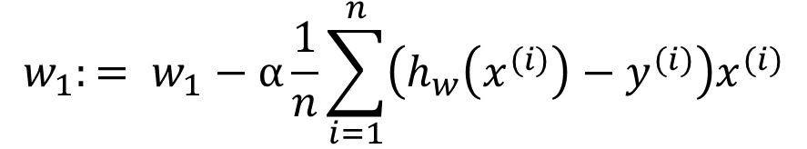
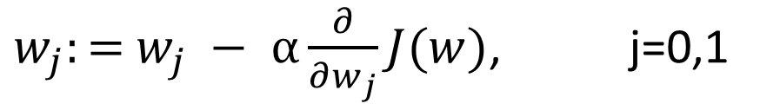
Gradient descent algorithm for linear regression
$w_{j}:=$ $w_{j} − α\frac{∂}{∂w_{j}}J(w)$, j=0,1
$$w_{0}:= w_{0}−α\frac{1}{n}\sum_{i=1}^{n}{\left(h_{w}\left(x^{(i)}\right)−y^{(i)}\right)}$$
Update $w_{0}$ and $w_{1}$
simultaneously
$$w_{1}:= w_{1}−α\frac{1}{n}\sum_{i=1}^{n}{\left(h_{w}\left(x^{(i)}\right)−y^{(i)}\right)x^{(i)}}$$

Slide 26
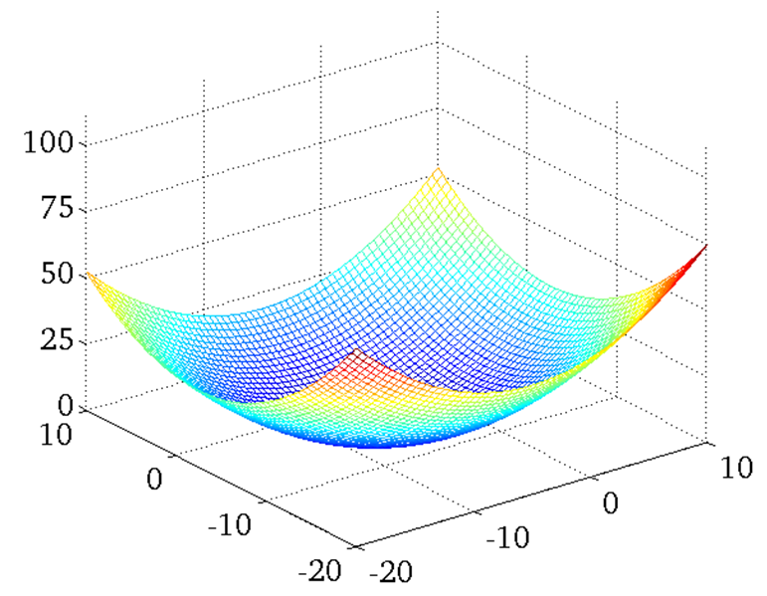



Minimum of Linear Regression: global or local?
Convex function
$$J\left(w_{0}{,w}_{1}\right)$$
bowl-shaped
$$w_{0}$$
$$w_{1}$$

Slide 27

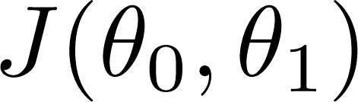


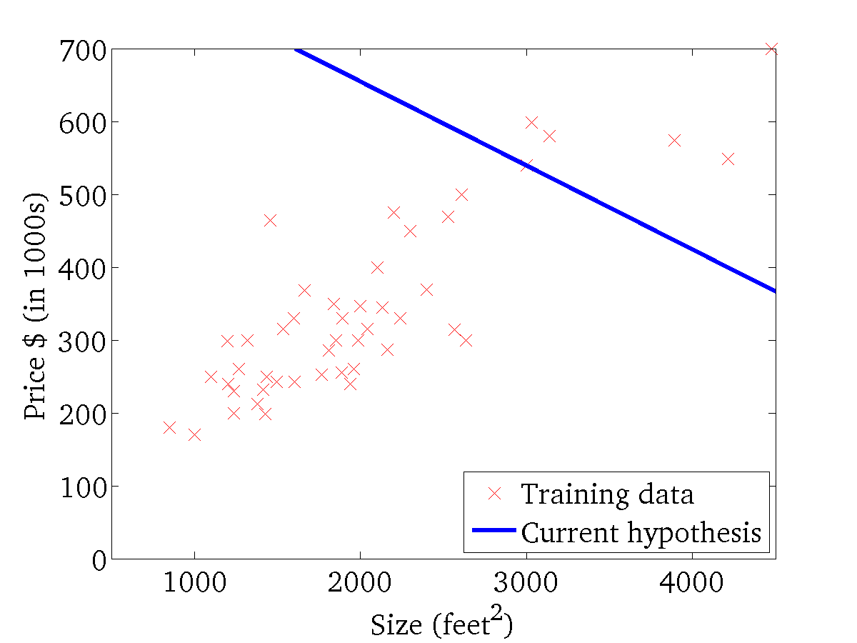
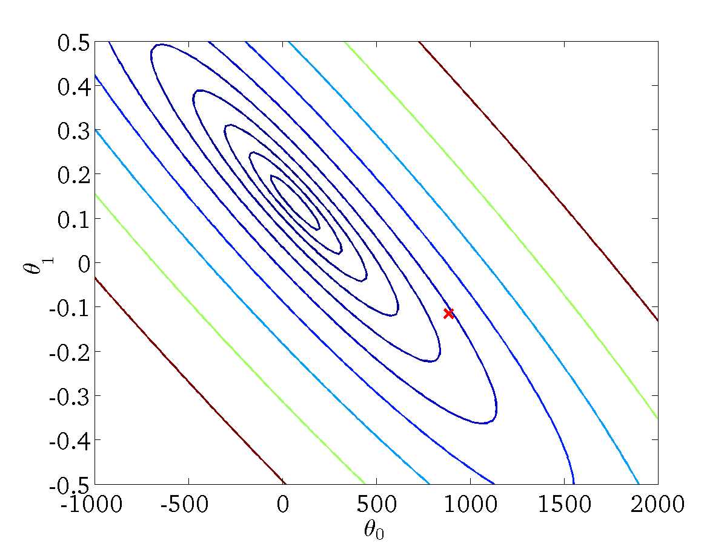
(for fixed , this is a function of x)
(function of the parameters )
This example was implemented for Training set of housing prices (Portland, OR)
https://www.coursera.org/learn/machine-learning

Slide 28
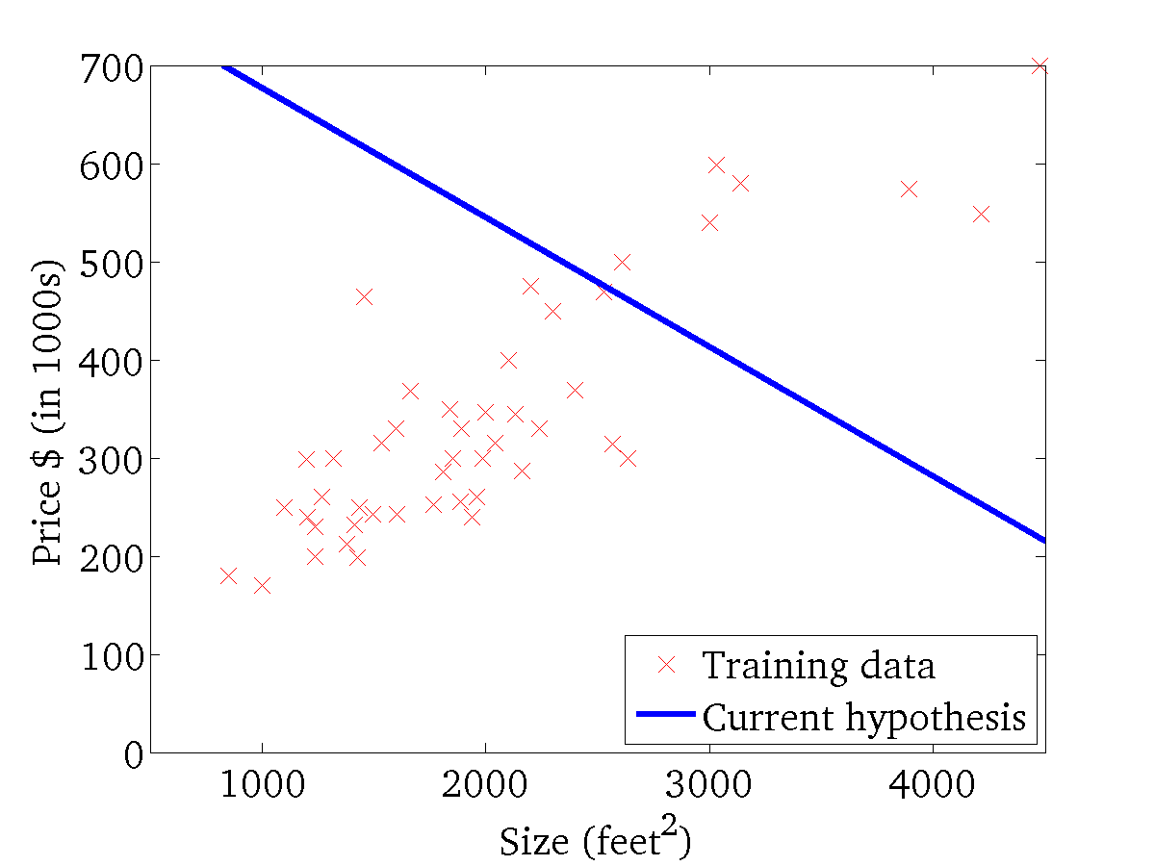

(for fixed , this is a function of x)
(function of the parameters )

Slide 29
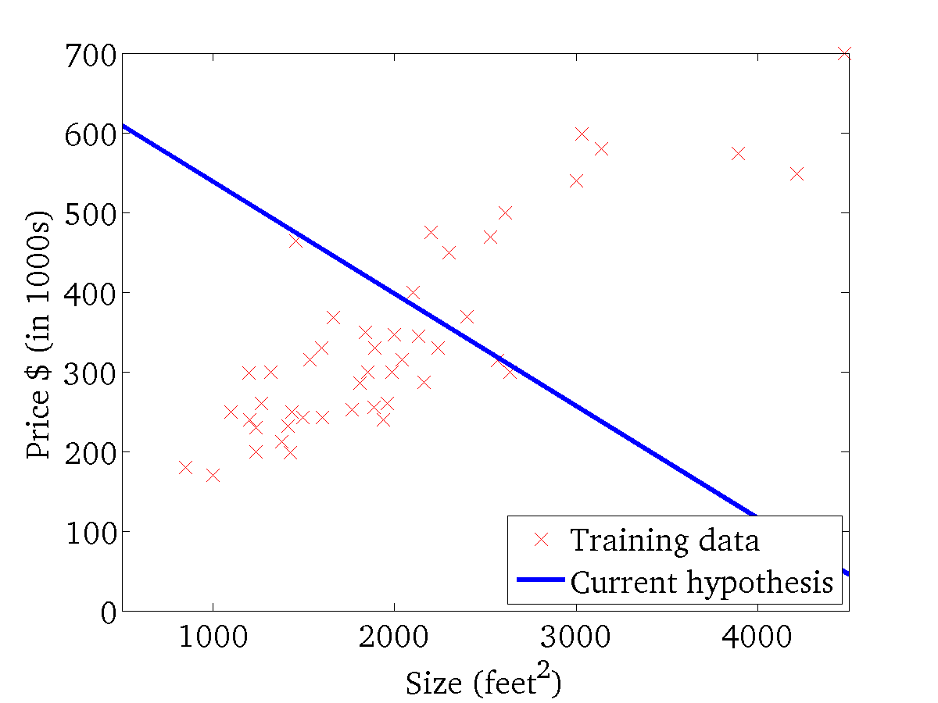
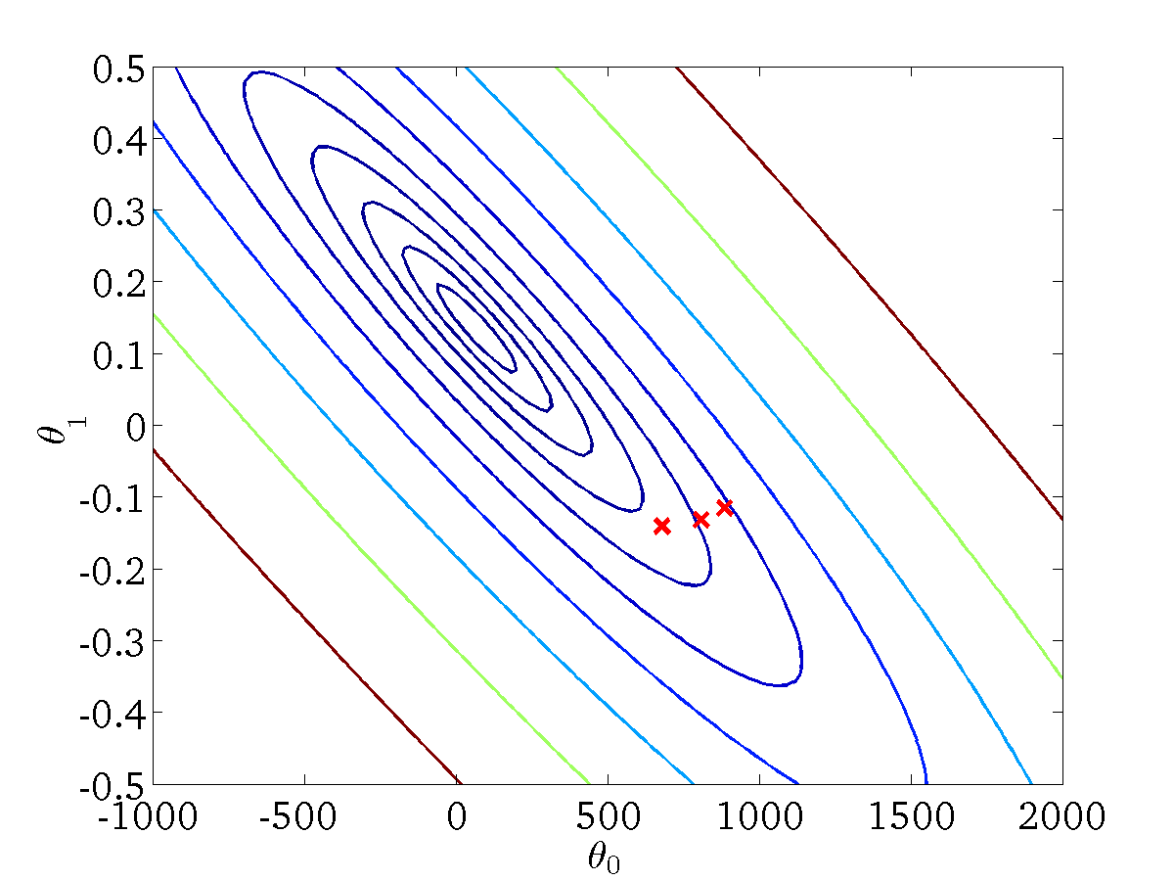
(for fixed , this is a function of x)
(function of the parameters )

Slide 30
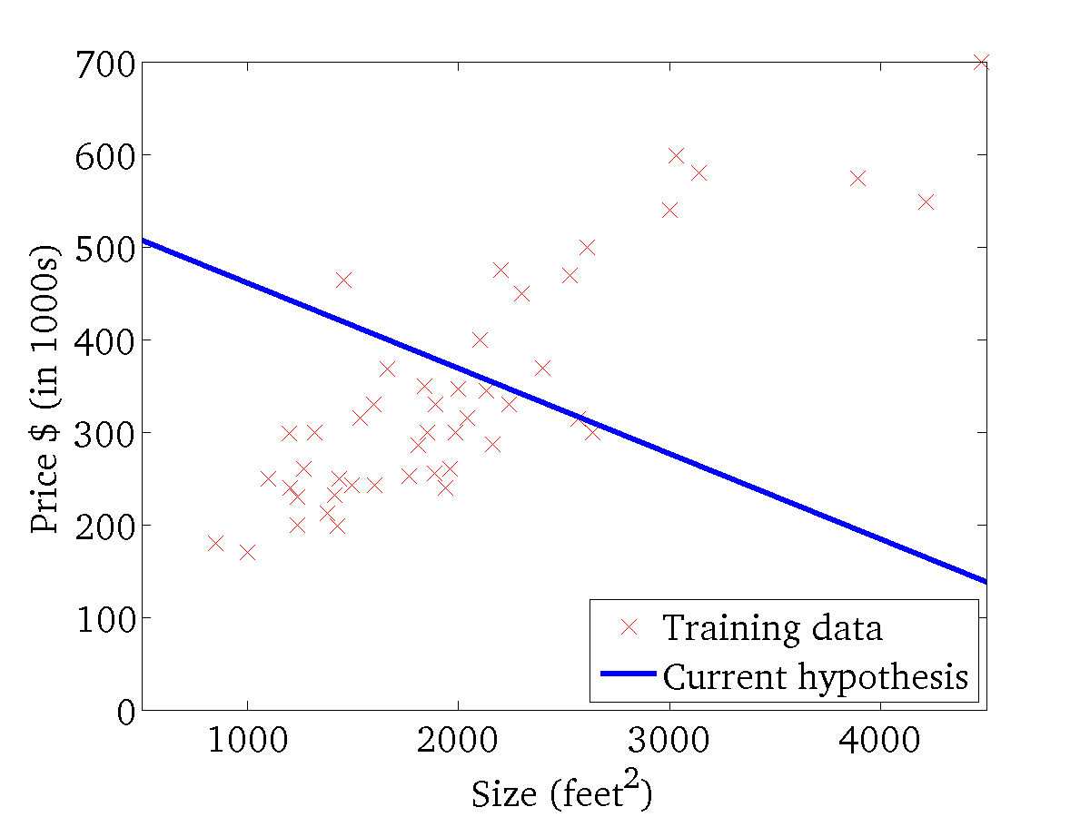

(for fixed , this is a function of x)
(function of the parameters )

Slide 31
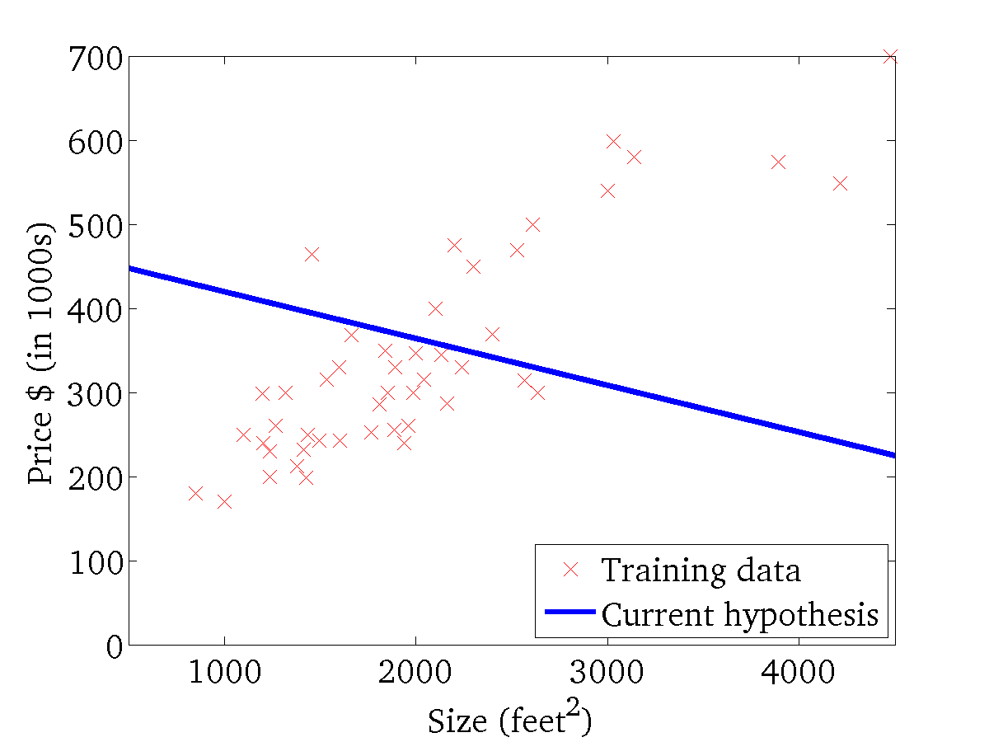
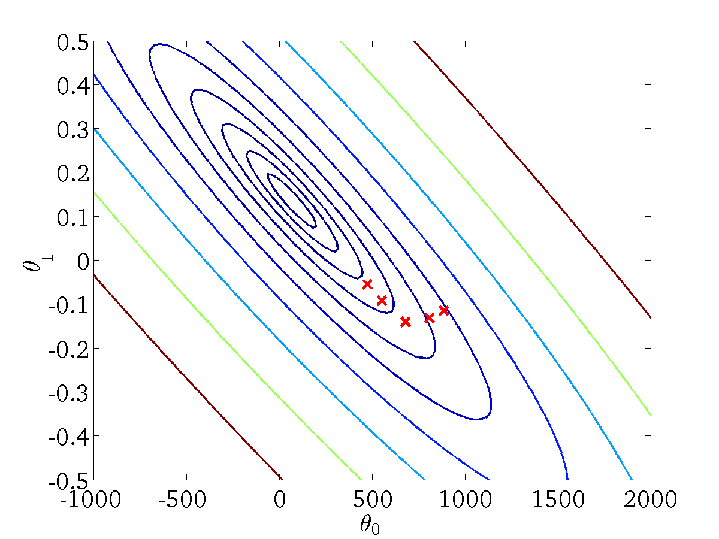
(for fixed , this is a function of x)
(function of the parameters )

Slide 32
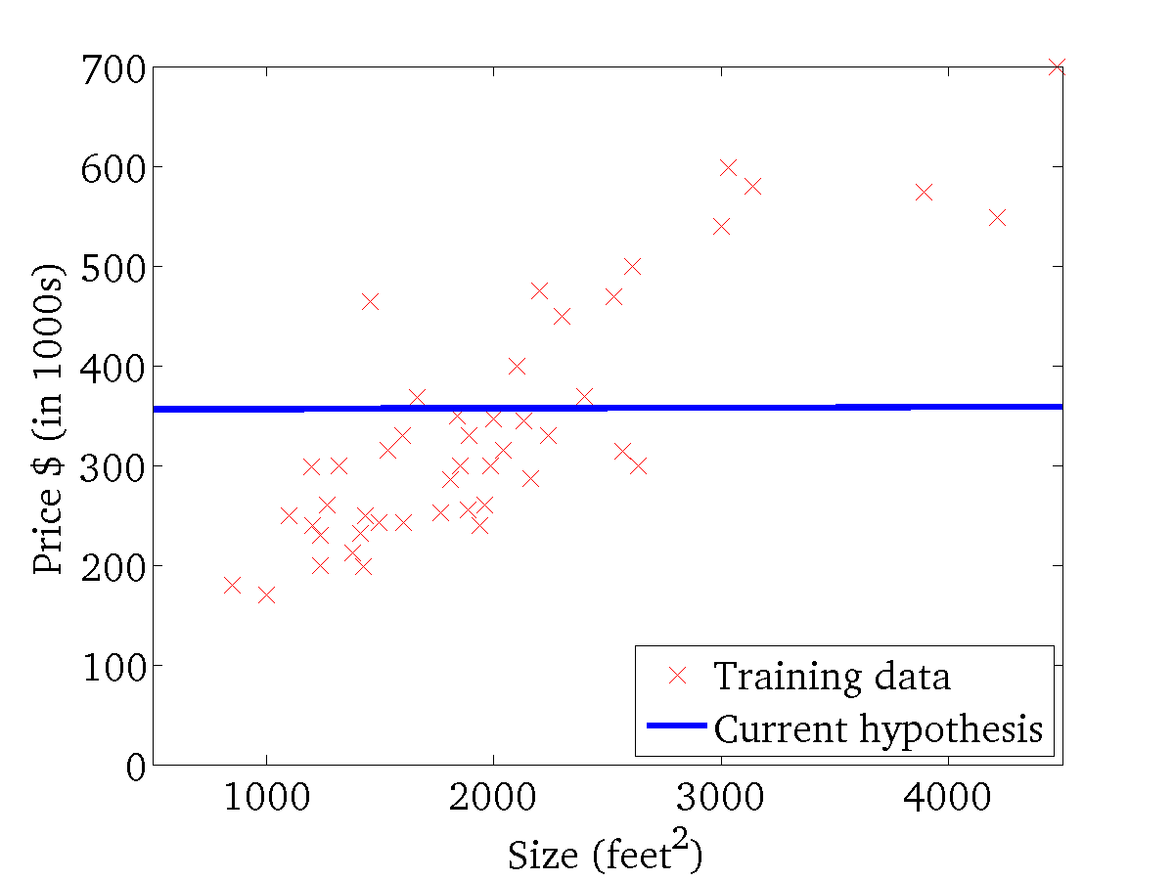

(for fixed , this is a function of x)
(function of the parameters )

Slide 33
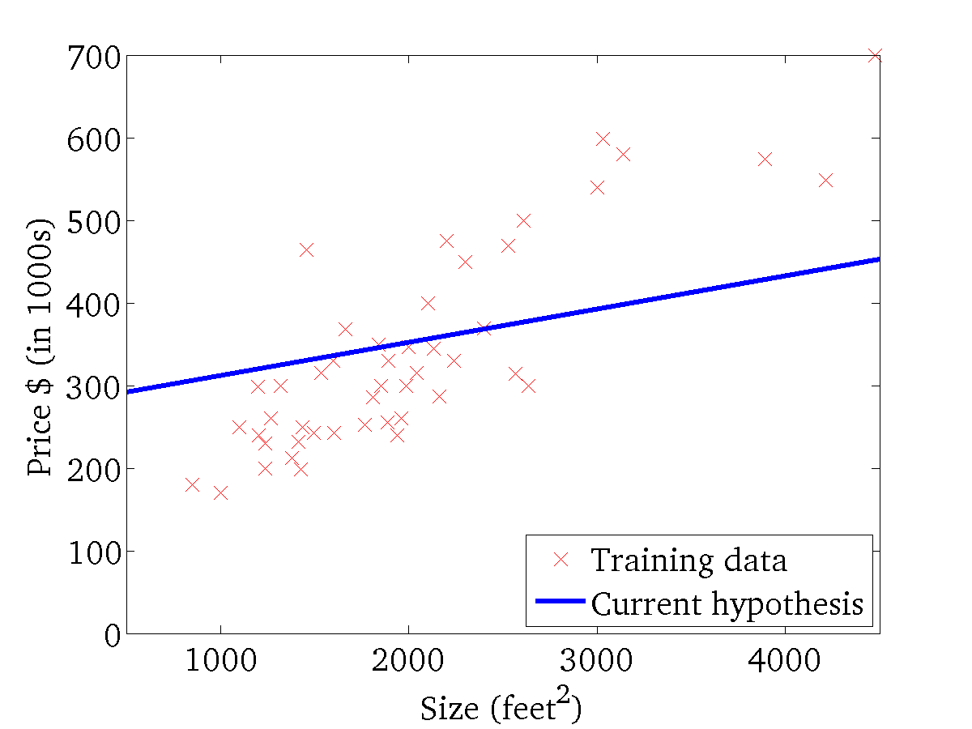

(for fixed , this is a function of x)
(function of the parameters )

Slide 34
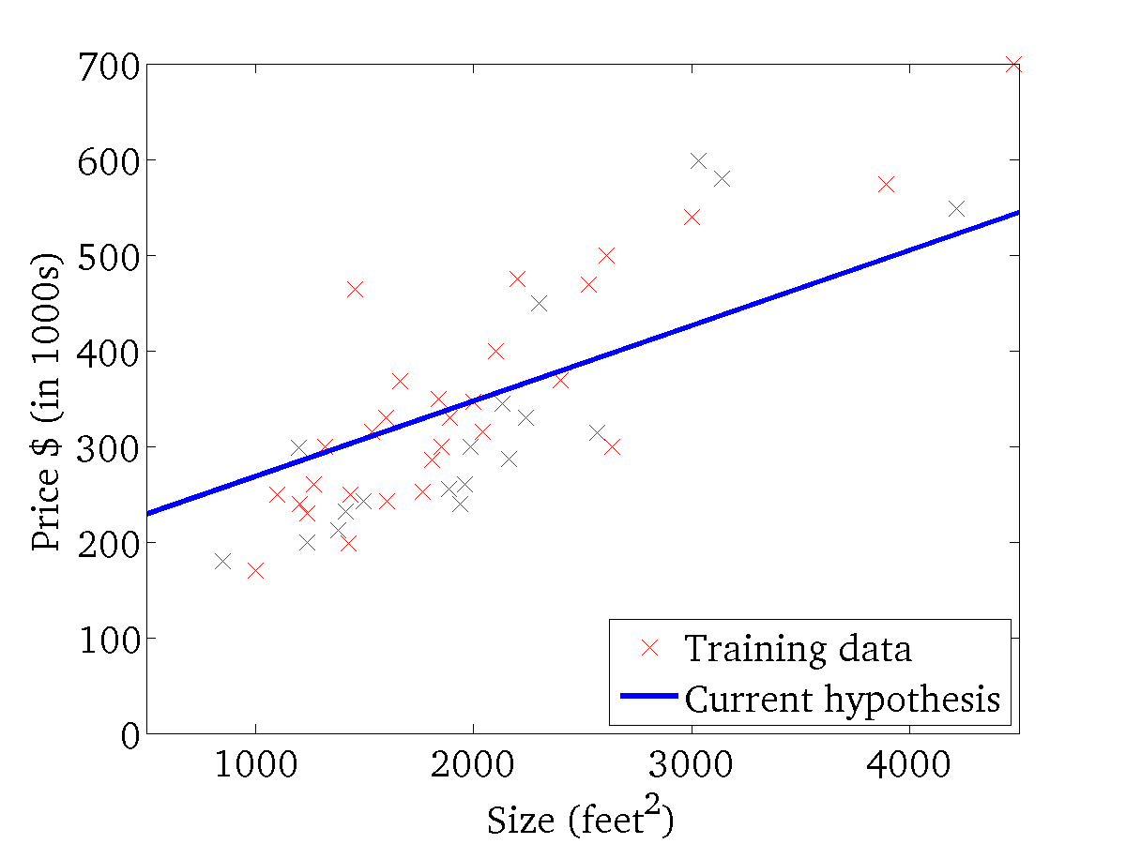
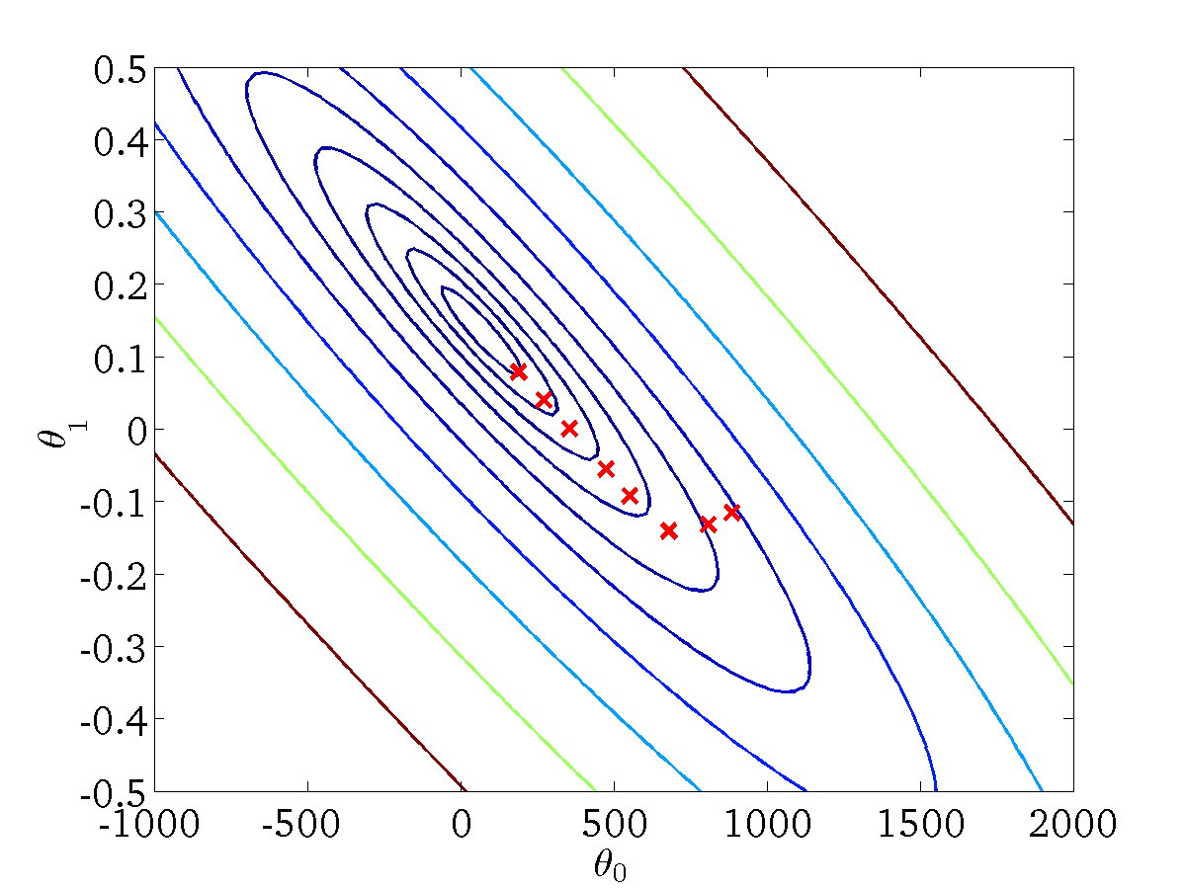
(for fixed , this is a function of x)
(function of the parameters )

Slide 35
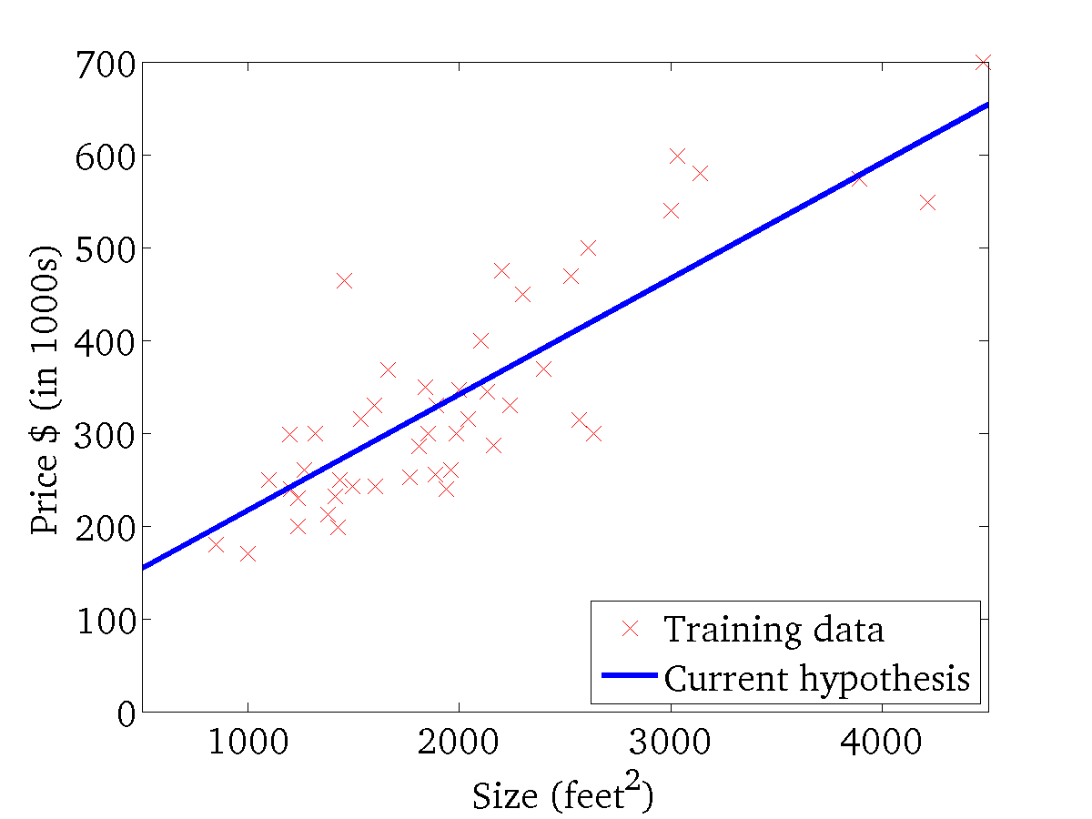

(for fixed , this is a function of x)
(function of the parameters )
Useful Link: https://xavierbourretsicotte.github.io/animation_ridge.html

Slide 36
“Batch” Gradient Descent
“Batch”: Each step of gradient descent uses all the training examples.

Slide 37
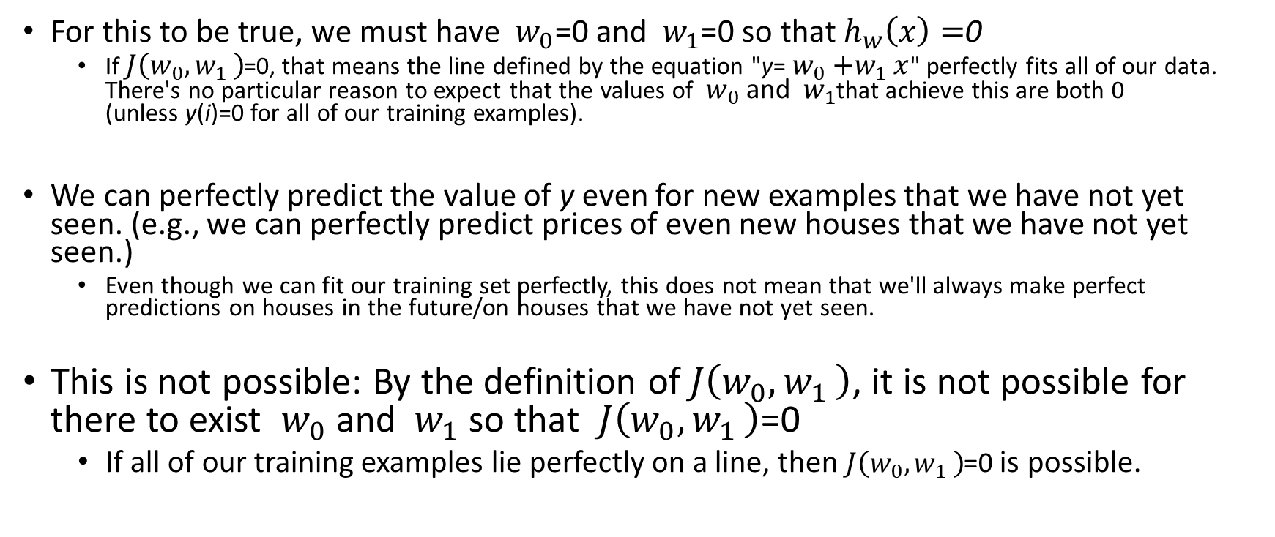
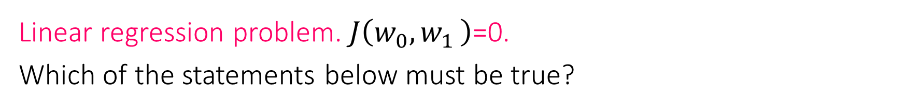
Linear regression problem. $J\left(w_{0}{,w}_{1}\right)$=0. Which of the statements below must be true?
For this to be true, we must have $w_{0}$=0 and $w_{1}$=0 so that $h_{w}\left(x\right)=$0
If $J\left(w_{0}{,w}_{1}\right)$=0, that means the line defined by the equation "y= $w_{0}{+w}_{1}x$" perfectly fits all of our data. There's no particular reason to expect that the values of $w_{0}$and $w_{1}$that achieve this are both 0 (unless y(i)=0 for all of our training examples).
We can perfectly predict the value of y even for new examples that we have not yet seen. (e.g., we can perfectly predict prices of even new houses that we have not yet seen.)
Even though we can fit our training set perfectly, this does not mean that we'll always make perfect predictions on houses in the future/on houses that we have not yet seen.
This is not possible: By the definition of $J\left(w_{0}{,w}_{1}\right)$, it is not possible for there to exist $w_{0}$and $w_{1}$ so that $J\left(w_{0}{,w}_{1}\right)$=0
If all of our training examples lie perfectly on a line, then $J\left(w_{0}{,w}_{1}\right)$=0 is possible.

Slide 38
Reading Material:
Andrew Ng. Supervised learning. http://cs229.stanford.edu/notes2019fall/cs229-notes1.pdf
Machine Learning Crash Course by Google.
https://developers.google.com/machine-learning/crash-course

